Slide 1
Teach An Agent To Drive A Car In A Virtual Environment
(Final Project Presentation)
Anant Vignesh Mahadhevan
Rakesh Ramesh
Dewang Shah

Slide 2
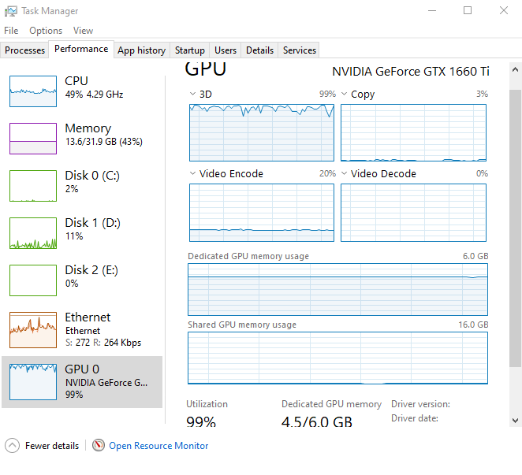
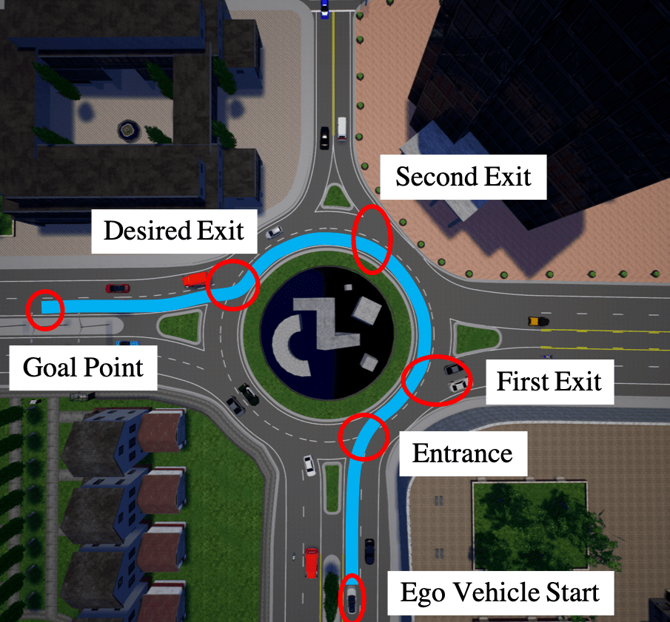
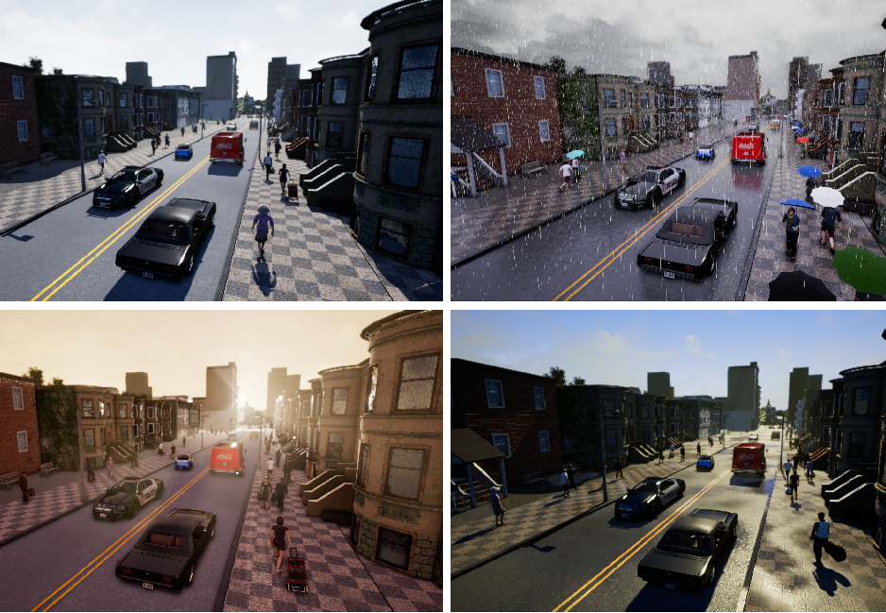
Introduction
Problems investigated:
1. Best ways to train our agent efficiently
2. Training the agent in different circumstances
3. Improving the model accuracy and average rewards over time

Slide 3
Introduction (Cntd.)
Intended Contribution of the investigation that is new from past similar efforts (Anything new since the last presentation?)
Completing the code to train the agent in different conditions
Creating the script for running the model
Creating new model
Introducing checkpoints system in the training script
Collectively training the agent for 12,000 episodes

Slide 4
Literature Review
[1]David Ha, Jurgen Schmidhuber, World Models
[2]Dorsa Sadigh, Shankar Sastry, Sanjit A. Seshia, and Anca D. Dragan- Planning for Autonomous Cars that Leverage Effects on Human Actions
[3]Timothy P. Lillicrap, Jonathan J. Hunt, Alexander Pritzel, Nicolas Heess, Tom Erez, Yuval Tassa, David Silver & Daan Wierstra- Continuous Control With Deep Reinforcement Learning
[4] Denis Yarats, Amy Zhang, Ilya Kostrikov, Brandon Amos, Joelle Pineau, Rob Fergus, Improving Sample Efficiency in Model-free Reinforcement learning from Images
[5] David Isele, Reza Rahimi, Akansel Cosgun, Kaushik Subramanian and Kikuo Fujimura, Navigating Occluded Intersections with Autonomous Vehicles using Deep Reinforcement Learning
[6]Chenyi Chen, Ari Seff, Alain Kornhauser, Jianxiong Xiao- DeepDriving: Learning Affordance for Direct Perception in Autonomous Driving
[7]Matt Vitelli, Aran Nayebi, CARMA: A Deep Reinforcement Learning Approach to Autonomous Driving.
[8]Abdur R. Fayjie, Sabir Hossain, Doukhi Oualid, and Deok-Jin Lee- Driverless Car: Autonomous Driving Using Deep Reinforcement Learning In Urban Environment.
[9]Brody Huval, Tao Wang, Sameep Tandon, Jeff Kiske, Will Song, Joel Pazhayampallil, Mykhaylo Andriluka, Pranav Rajpurkar, Toki Migimatsu, Royce Cheng-Yue, Fernando Mujica, Adam Coates, Andrew Y. Ng - An Empirical Evaluation of Deep Learning on Highway Driving

Slide 5


Methodology and Design (Datasets)
Tried Sensors: LIDAR, cameras, accelerometers, and so on.
These data sensors capture the environment around it, after which we pass the data to a function which pre-processes it. We also set the reward condition, which is whenever the agent doesn’t collide.
Primary: RGB Camera Sensor Collision Sensor

Slide 6
Methodology and Design (Models)
Xception Model - A convolutional neural network architecture based entirely on depthwise separable convolution layers
In order to train a model that teaches itself to drive a car in the CARLA environment, we wrote a custom model that has 3 convolutional layer with 3 average pooling layers.
It is essentially a CNN model. We added 3 neurons in the output layer, each one for left, right and straight movement prediction.

Slide 7


Methodology and Design (States/Action/Rewards)
Actions:
-left (0) -straight (1)
-right (2)
Environment
State:
every frame captured by RGB camera is a state
Rewards:
+1 for each frame driving > 50KMH -1 for each frame driving < 50KMH -200 for a collision and episode is over
Agent

Slide 8
Software
The main software we are using is the environment CARLA. The main idea of CARLA is to have the environment as server and then agents as clients. These are the versions of softwares and libraries which we have used:
Python 3.7
Keras 2.2.4
Tensorflow 1.14.0
CARLA 0.9.5
CUDA 7
Flow of our script:
Creating the car environment with pre processing steps.
Creating the DQN class which house the RL model with other concepts.
A main function which calls all of the above.

Slide 9
Training, Analysis and evaluation:
DQN and Fixed Target Model
Since we are using DQN, we’ll be using a model to infer the Q values instead of a table.
As we engage in the environment, we will do a .predict() to figure out our next move (or move randomly). When we do a .predict(), we will get the 3 float values, which are our Q values that map to actions.
We will then do an argmax on these, like we would with our Q Table's values. We will then "update" our network by doing a .fit() based on updated Q values.
When we do this, we will actually be fitting for all 3 Q values, even though we intend to just "update" one.
We are using a concept called ‘Fixed Target Network’, as our model is starting off as random, and it's being updated every single step, per every single episode.
This makes the model fluctuating and highly confusing.
Therefore, we develop a seperate model called the target_model() which will inherit the weights from the original model every n episodes.

Slide 10
Training, Analysis and evaluation:
Replay Memory
Replay memory which is another way that we attempt to keep some sanity in a model that is getting trained every single step of an episode.
When training the network, random minibatches from the replay memory are used instead of the most recent transition.
This breaks the similarity of subsequent training samples, which otherwise might drive the network into a local minimum.
Also experience replay makes the training task more similar to usual supervised learning, which simplifies debugging and testing the algorithm.

Slide 11
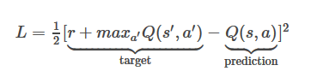
Training, Analysis and evaluation:
DQN working:
Do a feedforward pass for the current state s to get predicted Q-values for all actions.
Do a feedforward pass for the next state s’ and calculate maximum overall network outputs max a’ Q(s’, a’).
Set Q-value target for action to r + γmax a’ Q(s’, a’) (use the max calculated in step 2). For all other actions, set the Q-value target to the same as originally returned from step 1, making the error 0 for those outputs.
Update the weights using backpropagation.

Slide 12
Training, Analysis and evaluation:
The model was trained for 12,000 episodes with GTX 1660Ti.
We evaluated the model using the metrics such as accuracy, loss, reward average and epsilon by plotting them in a graph.
We developed a script to which the trained model will be added and it will interact with the environment.
This will be used to analyse the model’s performance in the environment in real time.
Advantages of DQN:
It addresses the state space-explosion problem.
Q-table is only capable of looking up for available states, if there is a state which is similar to available state DQN recognizes it.

Slide 13
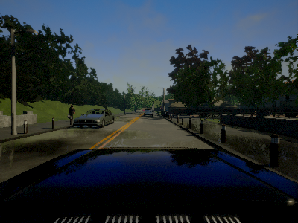
Experiments
Initial project parameters are, States: Every frame captured by the RGB sensor Actions: Left, Right, Straight Rewards: +1 for each frame driving > 50KMH, -1 for each frame driving < 50KMH, -200 for a collision Model: Xception
We started training the agent with the Xception model. The agent was spawned in the CARLA environment in random locations for every episode.
The reason why we did not go about spawning the agent in the same location because this will feed the episodes with the same set of states for every episode..
This will make the agent train with the same set of states for initial set of episodes and yield us very good Q-values for only those states. The agent will not be able to perform well with those calculated Q-values in other states.

Slide 14
Experiments: Issue With Xception Model
After creating the script with Xception model, the first thing we decided was to run the model for 1000 episodes but we were not getting decent results that we expected to get after 1000 long episodes.
This was because of our Xception model. Even though Xception is a good model to train self driving cars, it is an extremely complex model with 71 hidden layers. This increased our computational requirements which we did not have access to.
For this purpose, we wrote our own neural network that had 4 hidden layer CNN. In our case but simpler seems better as there are less parameters to learn.
For fully-supervised learning, we thought more parameters worked well because everything was a "ground truth."
For reinforcement learning, we decided it's just too hard for the AI to learn to drive a car by trying to train 10s of millions of weights.

Slide 15
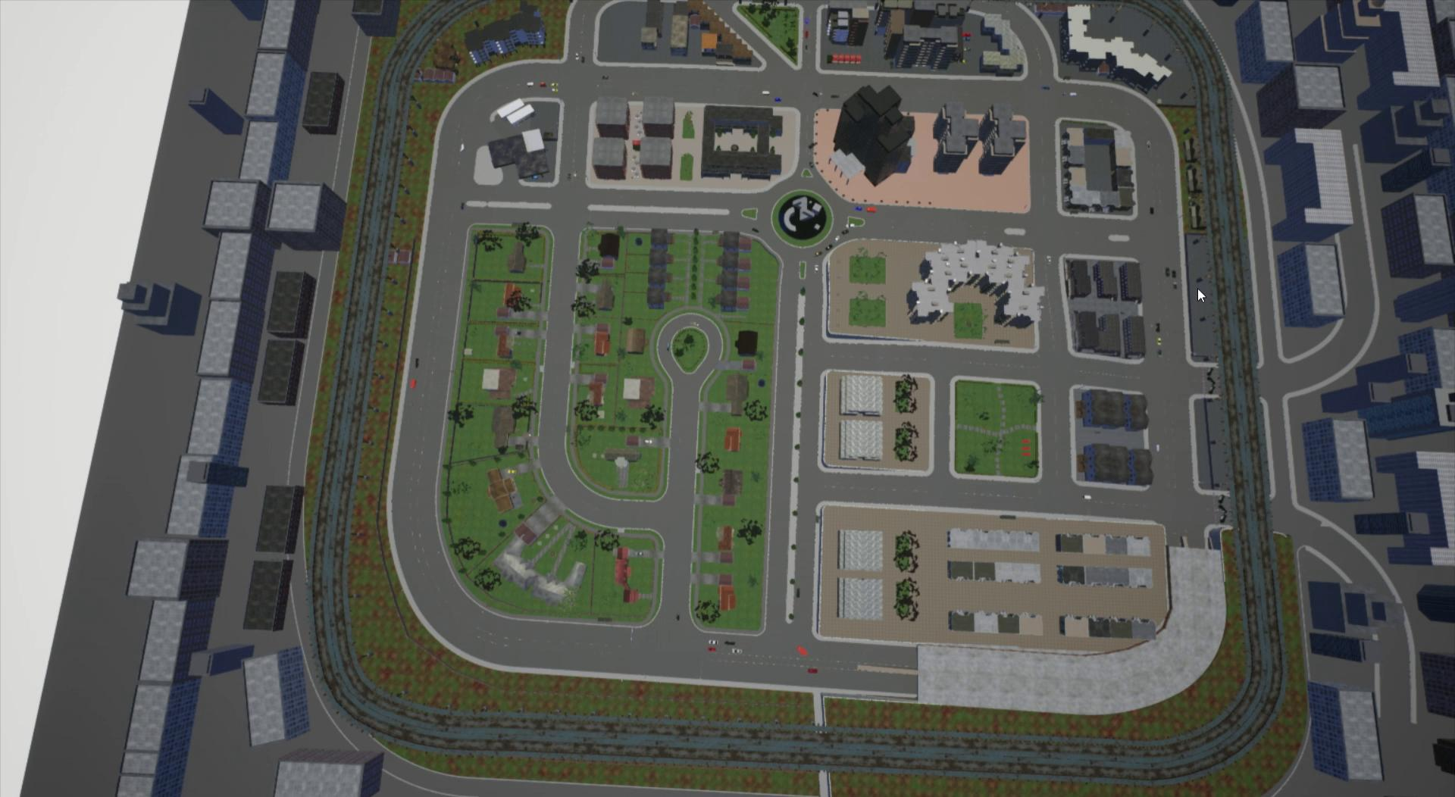
Experiment 1: Fully Dynamic Environment
Our first experimentation during the training phase was to train the agent in an environment with dynamic weather and dynamic traffic conditions with 100 other agents in the environment.
These other agents comprised of other vehicles of various sizes ranging from motorbikes, cars, and trucks. The agent also comprised of pedestrians who tend to cross the road at random moments.
Dynamic weather conditions will alter the lighting conditions and weather conditions randomly over time from a beautiful dry sunny day to really wet rainy day with dull lighting.
Although this is the apt environmental conditions that mimics the real world scenarios, we faced several problems during the training phase of the agent.
The first main hindrance was that since we are spawning our agent at random locations in the environment, the agent/car might land right on top of another agent in the environment and end the episode even before the agent starts to learn the environment.
And since there are lots of dynamic agents and conditions in the environment, a model that trained for around 5000+ episodes could not even make the agent drive in a straight road without colliding with another agent in the environment. This is because in the course of 5000+ episodes, the agent just fails numerous times even before starting to learn and adapt to the environment.

Slide 16
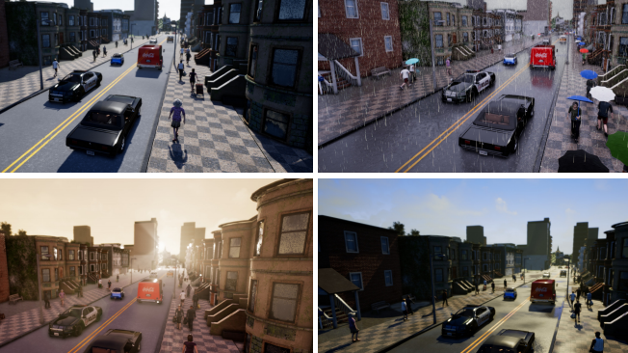
Experiment 2: Dynamic Weather Environment
Our next set of experiments involved removing dynamic traffic from the environment and just keep the dynamic whether.
This method of training the agent yielded much better results than the previous experiment.
As mentioned earlier dynamic whether conditions will alter the lighting conditions and weather conditions randomly over time.
Episodes that were trained during good lighting conditions became better over time but for the case of agents that were trained during dim and overcast conditions failed sooner because the RGB input that we were getting from the camera sensor were different than the bright images from the former conditions and hence required extra image processing in order to give reasonable results.
This requirement of extra image processing was an overhead for us as our computational capabilities were limited and hence an agent that was trained for 12,000 episodes did not give results that were decent enough.

Slide 17
Experiment 3: Simple Environment
Finally, we decided to just keep the environment in normal bright conditions without any dynamic traffic to make things simple and reduce the computational complexity.
When the agent was trained for 12,000 episodes in these conditions, we could see a decent enough model that was running very well in straight roads and also made decent left and right turn in the road when it was required occasionally.
The overall reason why we had to cut corners to get a decent enough model to drive a car was the computational constraints we had during the course of the project.

Slide 18
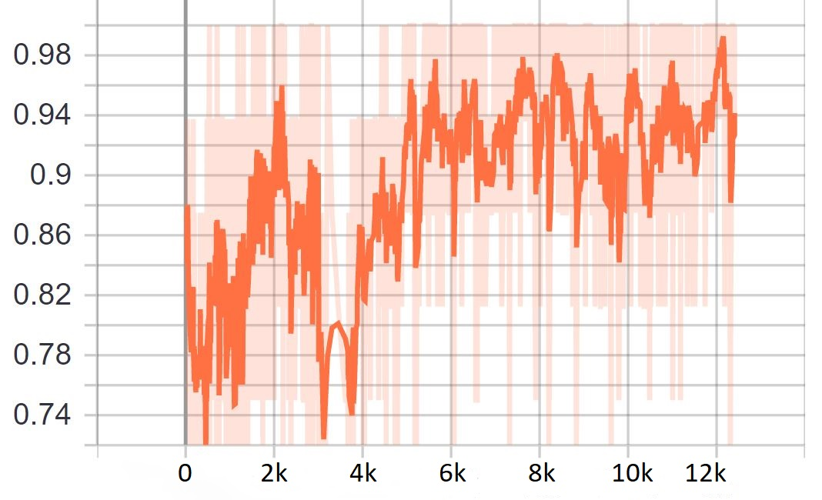
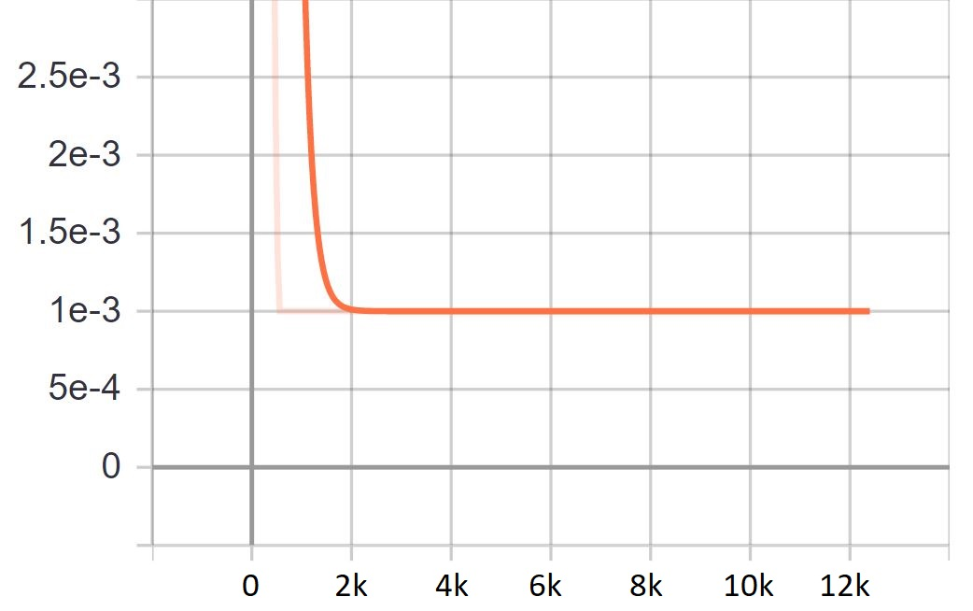
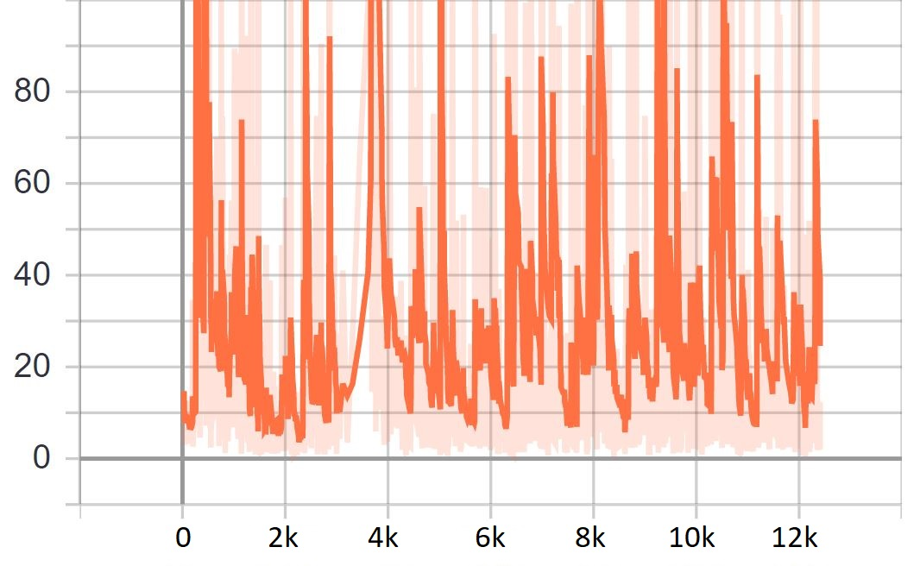
Discussion Of The Results
We trained the agent multiple times using the same model with checkpoints. The first time we trained the agent for 650 episodes. Then we reload from the checkpoint and continue to train to 3100 episodes. Finally, we complete the training at 12,000 episodes.
Following are the results we obtained in terms of accuracy, epsilon value, loss, the maximum, minimum, and the average reward:
From these graphs, we see that the accuracy for our model on an average was over a good 85%.
Next, we see that the epsilon, which shows our attempts to explore some more, helps sometimes, other times not really.
In loss rate, we see that there were no explosions.
Accuracy
Epsilon
Loss

Slide 19
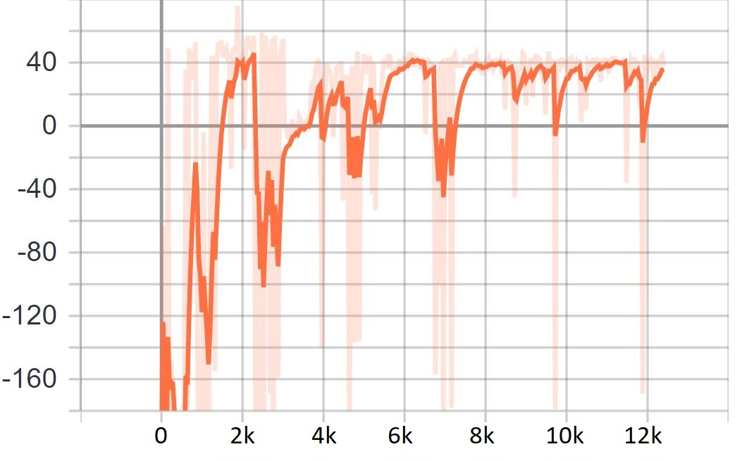
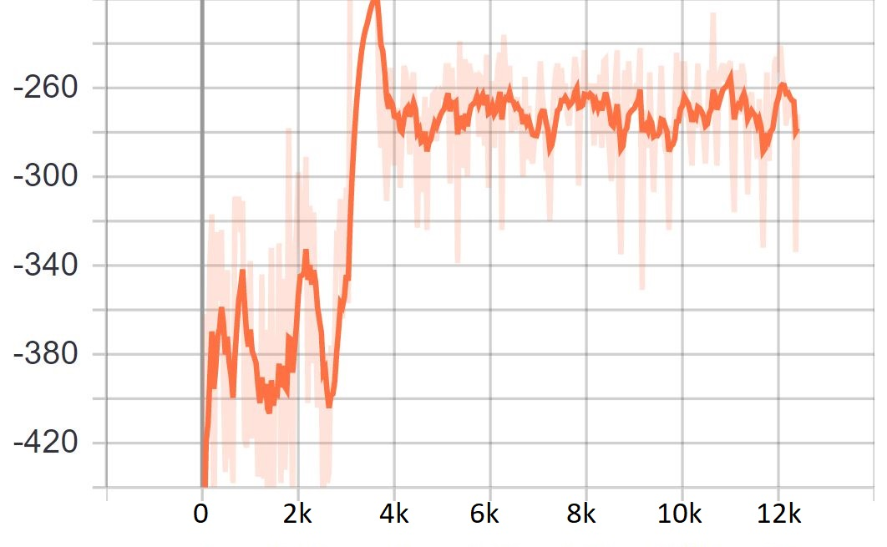
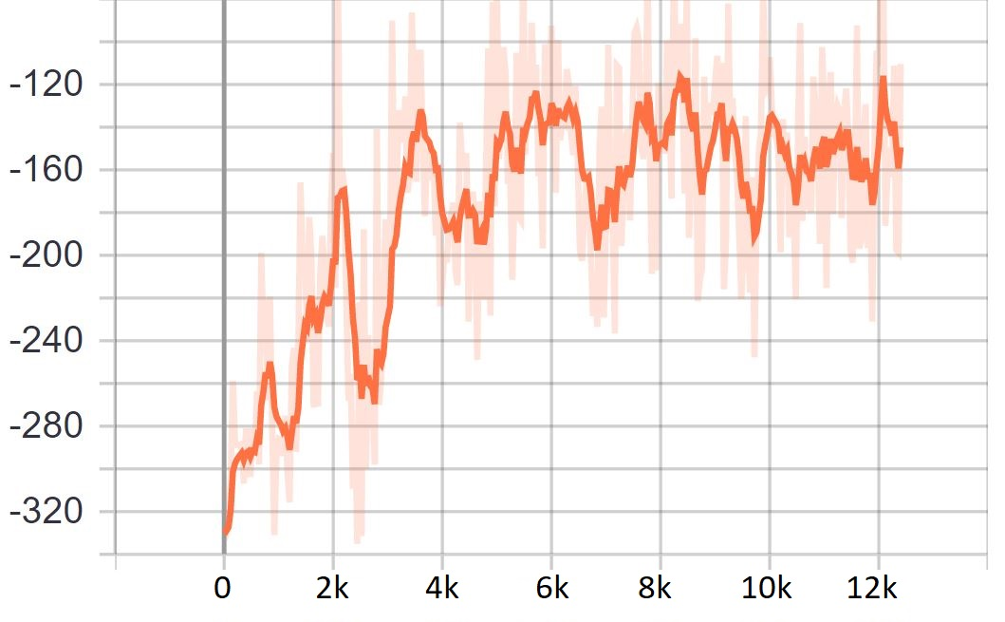
Discussion Of The Results
For rewards, We can see that the max reward over time does trend up until the 12,000 episodes, and may have continued back up given more time.
The minimum reward (ie: the worst an agent did), seemed to get better over the course of our training process. As we can see in the graph below, the agent seems to punish itself lesser than the initial epochs.
Sometimes the car is just dropped into an unfortunate setting. Finally, we can see that the reward average improved slowly, which meant that overall, the model did improve, and this model turned out to be our best performing model.
Reward Max
Reward Min
Reward Average

Slide 20
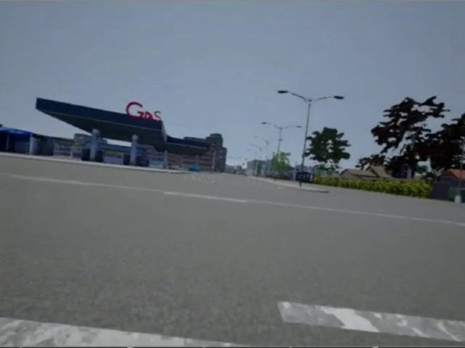
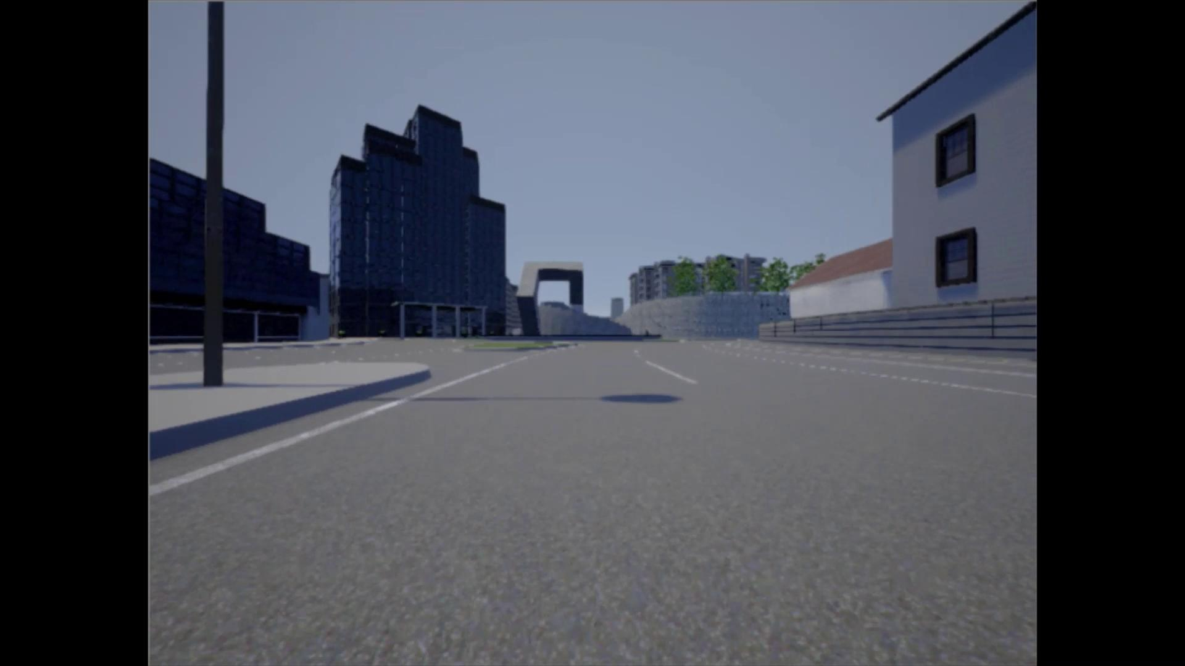
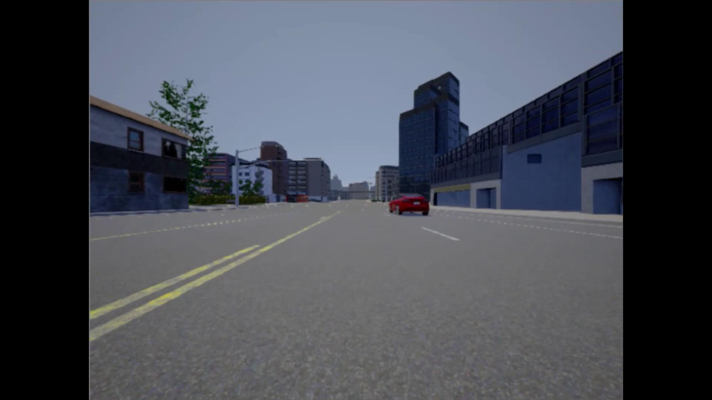
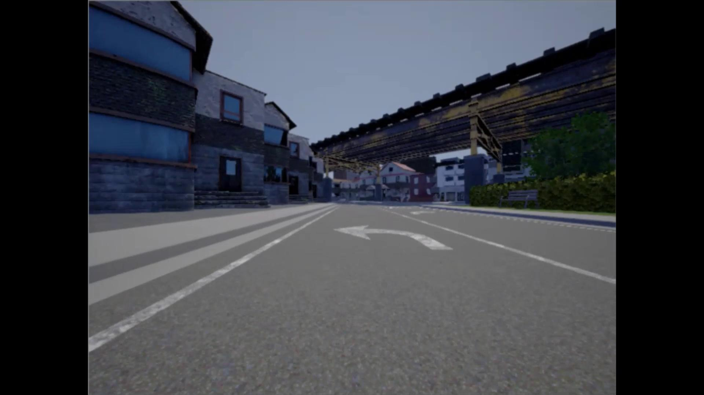
Final Result Of Our Agent
Agent After 1000 Episodes
Agent After 5000 Episodes
Agent After 10000 Episodes
Agent After 12000 Episodes

Slide 21
Future Works
In terms of future research, based on the computing power available, we would like to like to train the agent using the different models and parameters, for even more episodes, and compare the results of those models with each other, along with comparing the results at different episodic check points.
We would also like to increase the time taken for each episode, and retrain the model based on that, and check for the results. Our current computational capacity prevents us from taking those steps.
In terms of dynamic weather, we would like to devise and apply some image processing algorithms to brighten and improve the image quality, to help the agent make better choices based on the improved and more accurate values of the data. We would then like to select the best image processing algorithm which gives us the best results.
We would also like to devise an algorithm that could eradicate the problem of incorrect spawning of traffic vehicles, and then perform training the agent on this environment.
We also aim to add more actions for the agent to impact the environment, like reverse, and brake.

Slide 22
Update on plan and timeline of investigation and implementation
So far each of our team members has contributed equally by working together for the development of the script for sensor data collection.
Since we only had access to 1 powerful laptop in some certain days of the week, we planned to work together for the further script development process as well, while doing research in the other days of the week.
Rakesh Ramesh, Anant Vignesh, Dewang Shah - Developed scripts for DQN, environmental controls, and created the agent
Rakesh Ramesh, Anant Vignesh - Tried out different architectures
Dewang Shah - Tested and experimented on models
30th Oct - 15th Nov -> Development and implementation of the remaining scripts after mid term presentation
16th Nov - 29th Nov -> Tried out different architectures and addition of sensors, as per remaining time
30th Nov to Final Presentation -> Review and final testing

Slide 23
References
[1]Pan, You, Wang & Lu - Virtual To Real Reinforcement Learning, arXiv (2017) [2]Shai Shalev-Shwartz, Shaked Shammah, Amnon Shashua - Safe, Multi-Agent, Reinforcement Learning for Autonomous Driving, arXiv (2016) [3]Sahand Sharifzadeh, Ioannis Chiotellis, Rudolph Triebel, Daniel Cremers - Learning to Drive using Inverse Reinforcement Learning ANd DQN, arXiv (2017) [4]Markus Kuderer, Shilpa Gulati, Wolfram Burgard - Learning Driving Styles for Autonomous Vehicles from Demonstration, IEEE (2015) [5]Jeff Michels, Ashutosh Saxena, Andrew Y. Ng - High Speed Obstacle Avoidance using Monocular Vision and Reinforcement Learning, ACM (2005) [6]Ahmad El Sallab, Mohammed Abdou, Etienne Perot & Senthil Yogamani - Deep Reinforcement Learning Framework for Autonomous Driving, arXiv (2017) [7]Alexey Dosovitskiy, German Ros, Felipe Codevilla, Antonio Lopez, and Vladlen Koltun -CARLA: An Open Urban Driving Simulator. [8]April Yu, Raphael Palefsky-Smith, Rishi Bedi- Deep Reinforcement Learning for Simulated Autonomous Vehicle Control [9]Jan Koutník, Giuseppe Cuccu, Jürgen Schmidhuber, Faustino Gomez- Evolving Large-Scale Neural Networks for Vision-Based Reinforcement Learning [10]Chenyi Chen, Ari Seff, Alain Kornhauser, Jianxiong Xiao- DeepDriving: Learning Affordance for Direct Perception in Autonomous Driving [11]Timothy P. Lillicrap, Jonathan J. Hunt, Alexander Pritzel, Nicolas Heess, Tom Erez, Yuval Tassa, David Silver & Daan Wierstra- Continuous Control With Deep Reinforcement Learning [12]Brody Huval, Tao Wang, Sameep Tandon, Jeff Kiske, Will Song, Joel Pazhayampallil, Mykhaylo Andriluka, Pranav Rajpurkar, Toki Migimatsu, Royce Cheng-Yue, Fernando Mujica, Adam Coates, Andrew Y. Ng - An Empirical Evaluation of Deep Learning on Highway Driving [13]Abdur R. Fayjie, Sabir Hossain, Doukhi Oualid, and Deok-Jin Lee- Driverless Car: Autonomous Driving Using Deep Reinforcement Learning In Urban Environment. [14]Matt Vitelli, Aran Nayebi, CARMA: A Deep Reinforcement Learning Approach to Autonomous Driving. [15]David Isele1,Reza Rahimi,Akansel Cosgun,Kaushik Subramanian and Kikuo Fujimura- Navigating Occluded Intersections with Autonomous Vehicles using Deep Reinforcement Learning. [16]Dorsa Sadigh, Shankar Sastry, Sanjit A. Seshia, and Anca D. Dragan- Planning for Autonomous Cars that Leverage Effects on Human Action. [17]David Ha, Jurgen Schmidhuber, World Models [18] Denis Yarats, Amy Zhang, Ilya Kostrikov, Brandon Amos, Joelle Pineau, Rob Fergus, Improving Sample Efficiency in Model-free Reinforcement learning from Images

